Slide 1
aCGH-based Genomic Profiles
Estimating the right Copy Number Variations

Slide 2
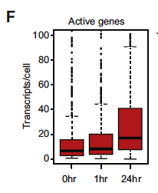
Model: human P-493-6 Burkitt’s lymphoma

Slide 4
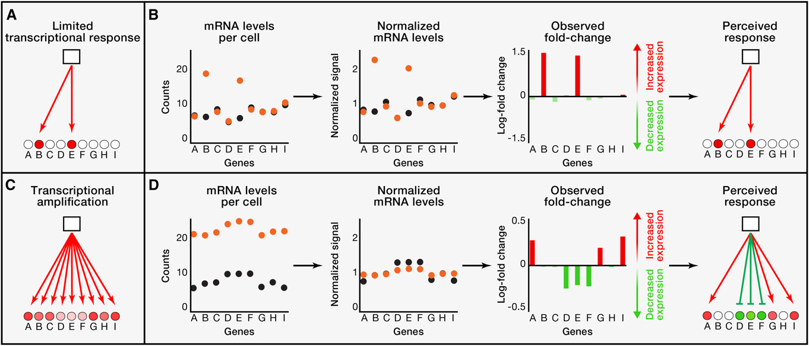
Equivalent levels of mRNA
Overall increase of mRNA (cMYC-amp cells)

Slide 5
What about DNA?

Slide 6

- NCI-60 cell lines panel with known karyotypes
- Comparison of Cy3 Vs. Cy5 intensity ranges in different ploïdy situations using 5 parameters logistic regression (5PL), and before any cyanine adjustment.

Slide 8
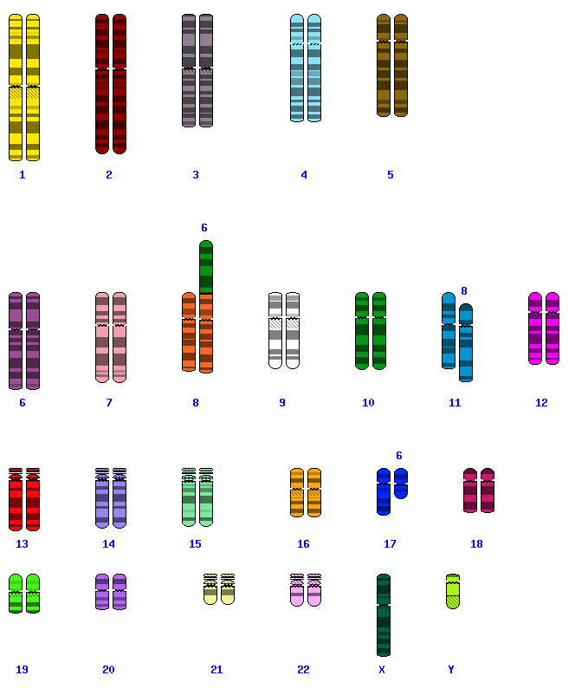
HCT-15: colon adenocarcinoma
Karyotype: near-diploid, 2n+/- (2n-)

Slide 9
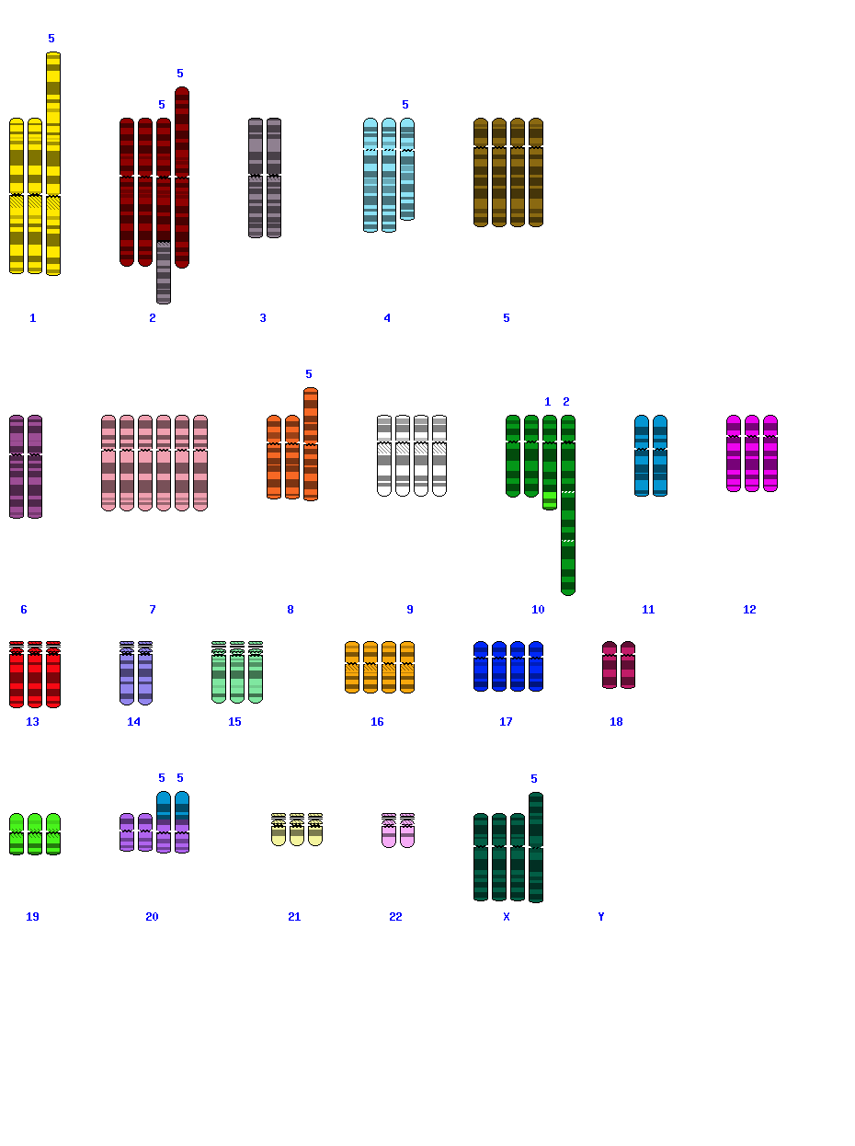
A498: renal carcinoma
Karyotype: triploid, 3n (3n-)

Slide 10
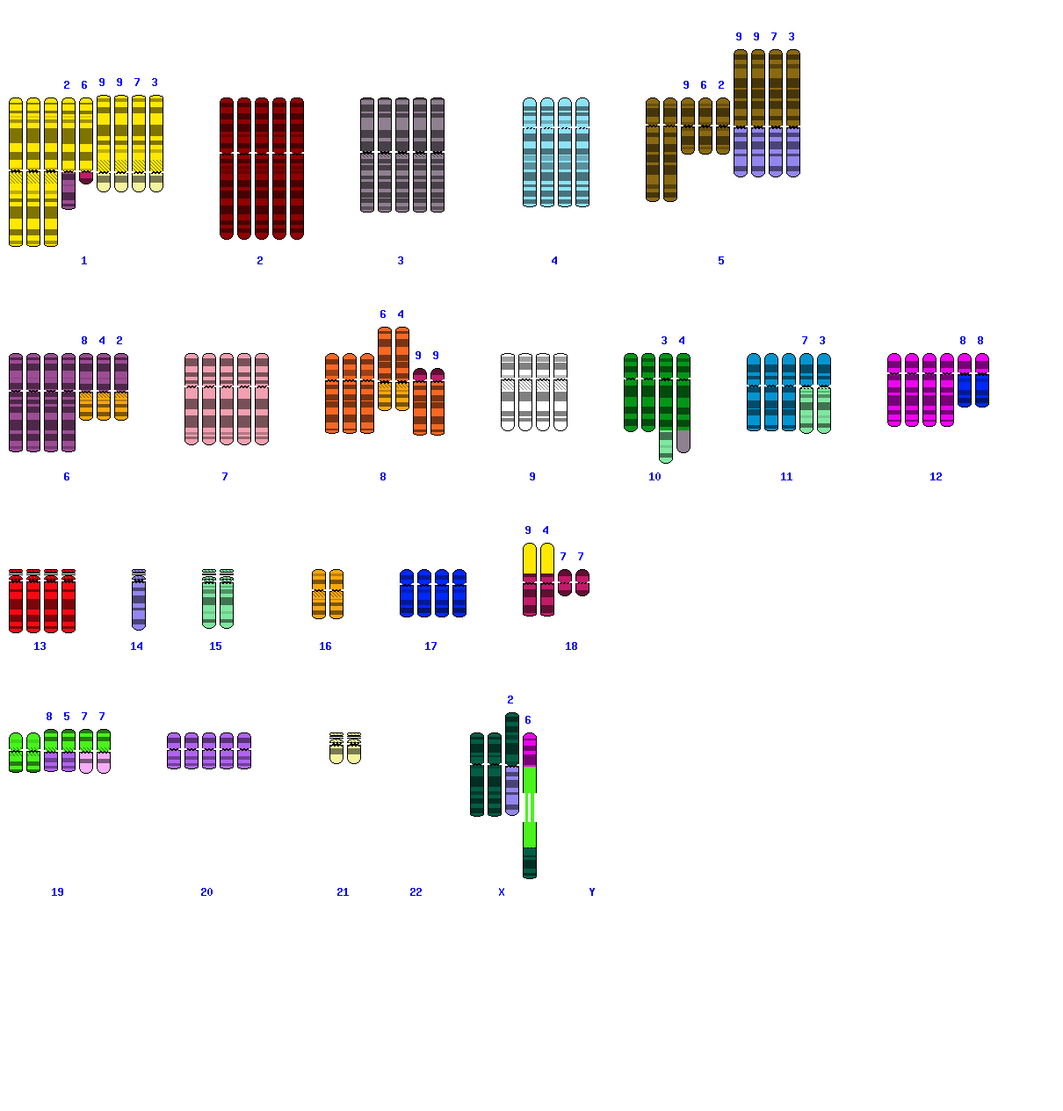
HOP-62: lung non-small-cell adenocarcinoma
Karyotype: hypertetraploid, 4n+

Slide 12
NCI-60 panel = 71 cell lines
~ 58% at least 3n

Slide 14
HOP-62: 4n+

Slide 17
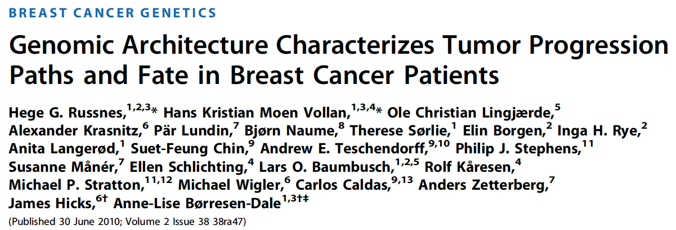
Other scores:

Slide 18
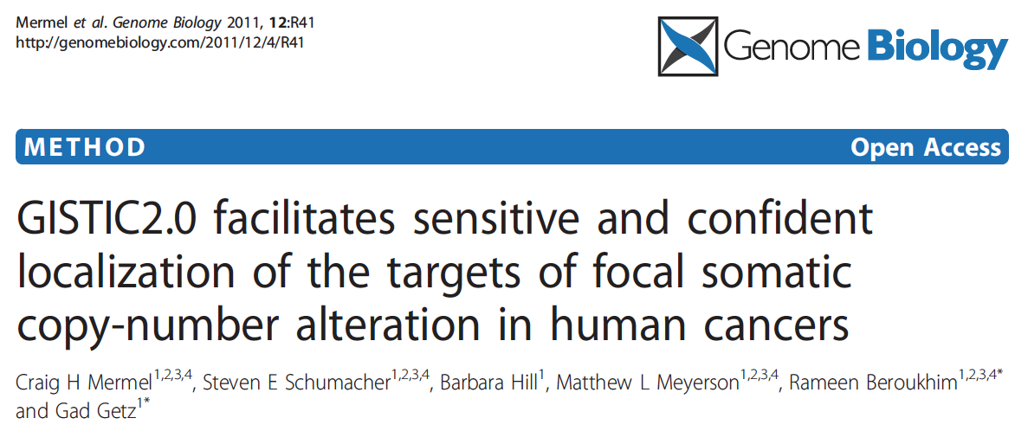
Other scores:
Focal GISTIC score at marker i (FG_{i}):
Based on the frequency of occurrences across a large dataset.

Slide 19
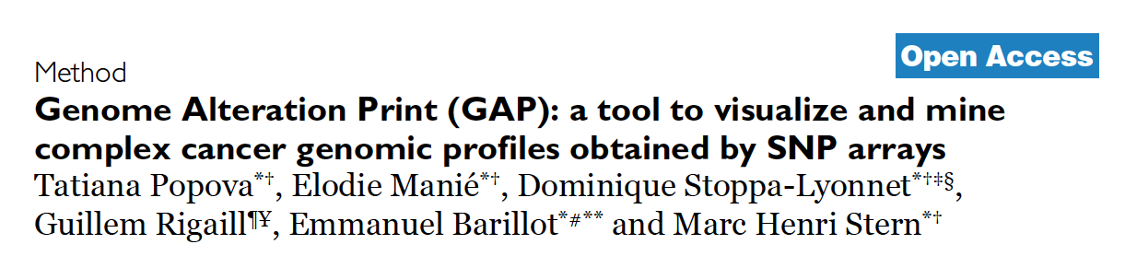
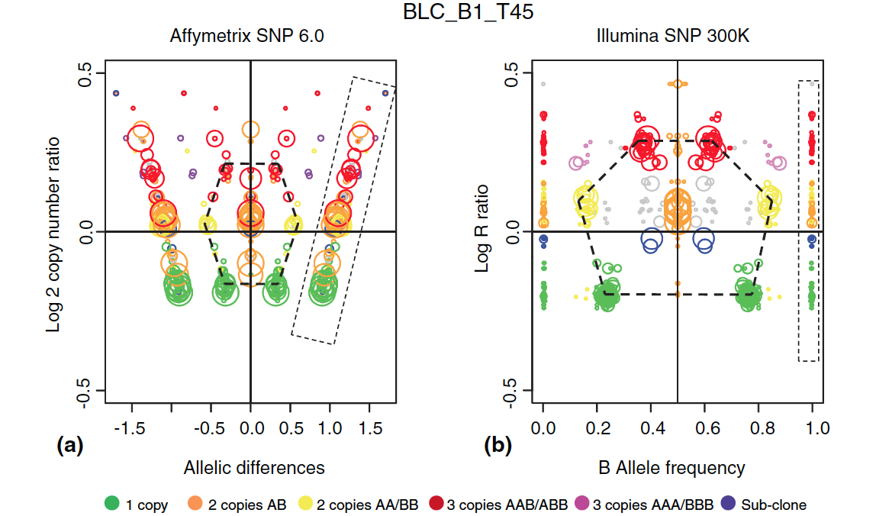
Other scores:
Only applicable when snp probes are available.

Slide 22
DNA (RNA) amounts are adjusted at the beginning of the procedure:
For technical considerations : labeling kits,…
For cross-sample adjustment (adjusting the number of cells?).
Loss of information and miss-interpretations. Discussed since 90’.
For gene expr. Loven et al. suggest to adjust on the quantity of DNA.
Maybe not a solution:
See NCI-60
How to transpose it to tissue samples?
Only breakpoints and local imbalances should be analyzed.

